Slide 1
A classification task in CHD
SCMR Series of Hands-on Workshops on Machine Learning
Olivier Jaubert
Research Fellow in MR Physics and Machine Learning
Centre for Translational Cardiovascular Imaging
UCL Institute of Cardiovascular Science
o.jaubert@ucl.ac.uk

Slide 2

License
This work is licensed under a Creative Commons Attribution 4.0 International License.
You are free to:
Share — Copy and redistribute the material in any medium or format.
Adapt — Remix, transform, and build upon the material for any purpose, even commercially.
Under the following terms:
Attribution — You must give appropriate credit, provide a link to the license, and indicate if changes were made. You may do so in any reasonable manner, but not in any way that suggests the licensor endorses you or your use.
No additional restrictions — You may not apply legal terms or technological measures that legally restrict others from doing anything the license permits.
© 2022 Javier Montalt-Tordera. Some Rights Reserved.

Slide 3
Contents
Basics of classification
Hands-on: Logistic regression
Introduction to classification in medical imaging
Hands-on: Building a classification model
Preparing the data
Hands-on: Preparing the data and running a classification
Next Session:
Improving performance and avoiding pitfalls (overfitting, data normalization, data augmentation, balancing the dataset, dropout, etc)
Hands-on: Image classification
Future of classification in CMR (different applications, papers and perspectives)

Slide 4
Basics of classification

Slide 5
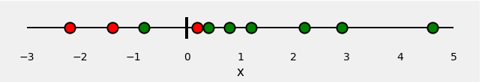
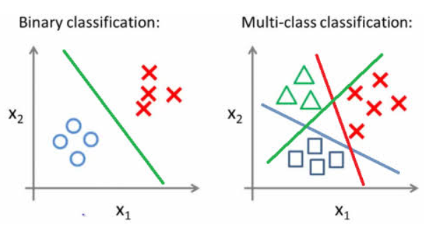
Classifying
Binary classification
Patient / Healthy
Binary classification Multi feature
Multi-class, Multi feature
Disease 1, 2, 3
Notes:
What do we mean by classifying ?
Simply put we aim at differentiating meaningful groups.
It can be Done in a binary way as shown here ->
Here we could imagine differentiating a group of patient from healthy given a single “feature” x which could correspond to something such as age, myocardial thickness or T1 value.
Similarly information can be combined, and use for exemple age and myocardial thickness to determine the same. This is then still a binary classification problem but with multiple input features.
Finally you can have a multi class and multi feature problem where you want to classify different diseases for exemple.

Slide 6
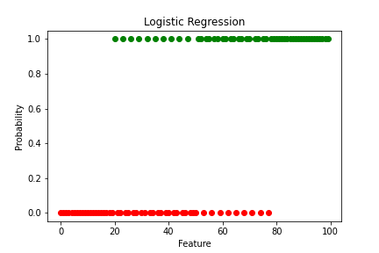
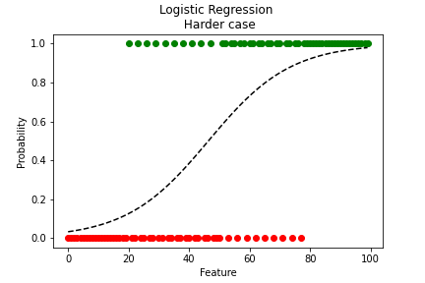
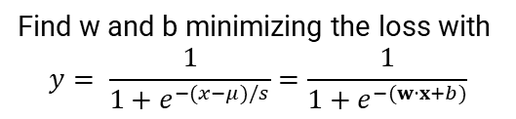
Find w and b minimizing the loss with $y=$ $w⋅x+b$
Logistic Regression
Linear regression
Binary classification
Probability outside of [0, 1]
Not a good probability estimator in case of class imbalance
Probability of a new point
with Feature = 30,50,80 to be of class 1 ?
Find w and b minimizing the loss with
$$y= \frac{1}{1+e^{−(x−μ)/s}}=\frac{1}{1+e^{−(w⋅x+b)}}$$
Logistic regression
Probability inside of [0, 1]
Notes:
They are maximum likelihood estimator for binomial distribution (cross-entropy), normal distribution(MSE).

Slide 7
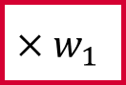
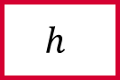
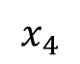

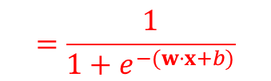
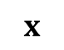
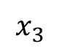
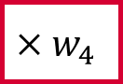
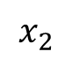


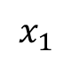

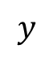
An artificial neuron
inputs
weights
neuron or unit
age
$$x_{1}$$
$$×w_{1}$$
$$×w_{2}$$
output
salt intake
$$x_{2}$$
$$+b$$
$$h$$
$$y$$
blood pressure
body mass index
$$x_{3}$$
$$×w_{3}$$
bias
activation function
alcohol intake
$$x_{4}$$
$$×w_{4}$$
$$x$$
$$w$$
Sigmoid function
$$=\frac{1}{1+e^{−(w⋅x+b)}}$$
$$y=h\left(w⋅x+b\right)$$

Slide 8
Loss function: Cross entropy
Classification tasks often use the cross entropy loss (i.e.log loss).
It is a better maximum likelihood estimator when assuming binomial distribution as in classification
Cross-entropy is a measure of dissimilarity between true labels pi and predicted label qi:
Notes:
Classification tasks often use the cross entropy loss (i.e.log loss).
Without going into the details, cross-entropy gives a measure of dissimilarity between true and predicted labels. It is maximum likelihood estimator for binomial distribution (cross-entropy) while MSE is a maximum likelihood estimator for normally distributed data (MSE).
It can be performed for multiple classes i.
For binary classification it gives this formula known as binary cross entropy.

Slide 9
Hands-on: Logistic regression using TensorFlow

Slide 10
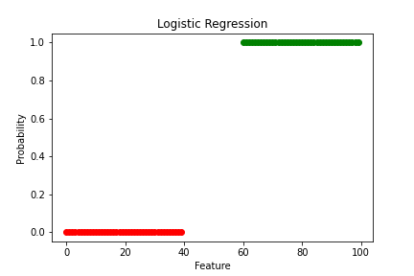
#Logistic regression
import numpy as np
import tensorflow as tf
import matplotlib.pyplot as plt
%matplotlib inline
x=np.concatenate((np.arange(0,40),np.arange(60,100)))
y=np.zeros(x.shape)
y[x.shape[0]//2:]=1
plt.figure()
plt.plot(x[y==0],y[y==0],'ro')
plt.plot(x[y>0],y[y>0],'go')
plt.xlabel('Feature')
plt.ylabel('Probability')
plt.title('Logistic Regression')
Import libraries
Create data
Plot data

Slide 11
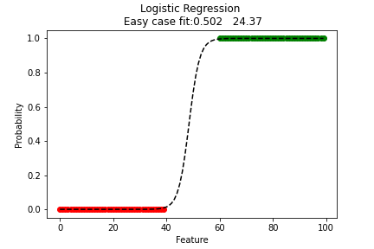
Define model
model = tf.keras.Sequential()
number_of_classes = 1
number_of_features = 1
model.add(tf.keras.layers.Dense(number_of_classes,activation = 'sigmoid',input_dim = number_of_features))
opt = tf.keras.optimizers.Adam(learning_rate=0.01)
loss= 'binary_crossentropy'
model.compile(optimizer=opt, loss=loss)
history= model.fit(x, y, epochs=1000,batch_size=5)
Fit the model using a loss and optimizer

Slide 12
Introduction to classification in medical imaging

Slide 13
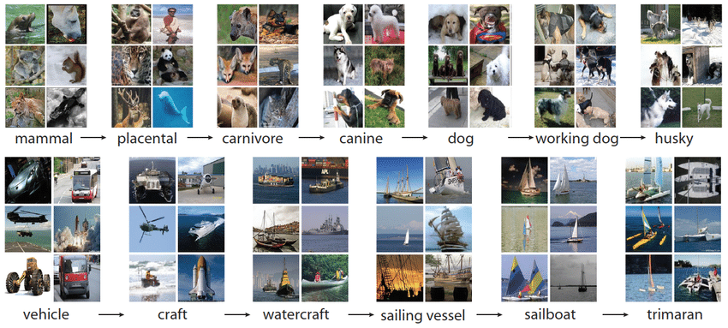
Fashion MNIST
ImageNet
T-shirt/top
T-shirt/top
dress
sandal
ankle boot
sneaker
trouser
coat
bag
Notes:
So far we’ve been handling abstract features.
Why would we want to apply classification to images. Well to extract structured information from images.
Many applications have risen autonomous driving, facial recognition and medical image analysis.
Here we show classical datasets used for classification challenges in natural images.
Fashion MNIST, which you’ve seen before aims at labelling fashion items.
And the famous ImageNet dataset with over 14 million annotated images.
These are largely used by the machine learning community to develop higher performance algorithm. They are very large and publicly available.

Slide 14
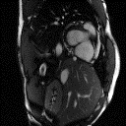
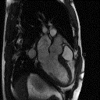
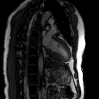

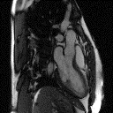
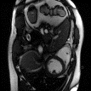
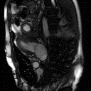
UK Biobank
Datasets for Cardiac MRI
OCMR
Notes:
In medical imaging although of lesser sizes and less available, a great effort is being made to obtain curated image datasets. For exemple, UK Biobank is a large dataset including more than 7000 cardiac MRI images with a lot of associated health data.
In the following exercise we will actually use the OCMR dataset from the Ohio State university which allowed us to share the images during this workshop. It consists of 183 different slices slices of Cine cardiac MRI in different orientations (124 SAX, 42 non SAX).

Slide 15
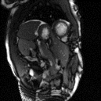
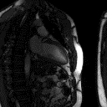
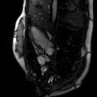
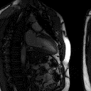
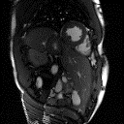
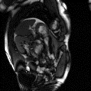
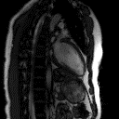
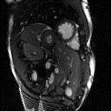
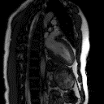
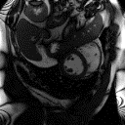
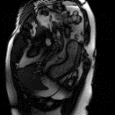
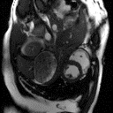
Classifying orientation
Notes:
As an exemple task for image classification we propose to classify the images’ orientation.
Imagine you have a huge dataset of images which you want to label according to their orientation in order to extract only short axis images.
We can see the huge variability in terms of anatomies, contrast, etc.

Slide 16
Image classification
Features ?
Rules ?
Answer
Short Axis
Notes:
Now you have an image as input.
Which is effectively a very large number of input features (equal to the number of pixel).
Traditionally you would code and extract expert designed features and classify the images according to these features.
The question is then which features and how do you extract them from the image ?
It turns out that classifying through man-made features is harduous, shows poor performance and is not very generalizable to different problems. For instance recognizing the difference between a cat and a plane might have very different rules.
Yet we as humans find this task very easy. After seeing only a few exemples we can recognize a short axis from long axis.

Slide 17
Machine learning for image classification
Machine Learning
Answers
Rules
Data
Data
Answers or labels
SAX
LAX
SAX
LAX
Notes:
And so for many problems it is much easier and more performant to provide Data and Answers and use machine learning tools to create a classifier rather than handcrafting it.
And so now given our small labelled dataset we will try to create a classifier enabling us to identify short axis images from a larger dataset.

Slide 18
Machine learning for image classification
Model ?
Probability it is a SAX
Notes:
Classically in classification, you will aim at contracting the input information into a decision/probability.
How is this usually performed ?

Slide 19
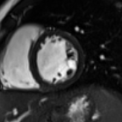
Building the model
higher resolution
Feature reduction
higher level semantics
4 feature maps or channels
8 feature maps
Dense layers
sigmoid activation
conv
pool
conv
pool
flatten
probability
? | ? | ?
? | ? | ?
? | ? | ?
filter or kernel
? | ? | ?
? | ? | ?
? | ? | ?
? | ? | ?
? | ? | ?
? | ? | ?
? | ? | ?
? | ? | ?
? | ? | ?
× 4 filters
? | ? | ?
? | ? | ?
? | ? | ?
× 8 filters
kernel size
trainable parameters
Notes:
A conventional way to do so is through multiple layers of successive convolutions, activations and pooling.
These are particularly effective in imaging to condense information into fewer features.
Dense layers at the end are then used to give relative weights between the extracted condensed imaging features.
A sigmoid output activation is then used to transform the output into a probability.
Trainable parameters are learned through back-propagation to minimize the loss function.

Slide 20
Hands-on: A simple classification model

Slide 21
Creating a Classification model
Import Libraries
def create_base_model(train_data,nLayers=4,nInitConvFilters=8,kernelSize=3):
# Determine and store the shape of the data
input_shape = (train_data.shape[1], train_data.shape[2], train_data.shape[3])
# Create the model
model = tf.keras.models.Sequential() #CNN layers with maxpooling
for ii in range(nLayers):
model.add(Conv2D(nInitConvFilters*2**ii, kernel_size=(kernelSize, kernelSize), padding='same', activation='relu'))
model.add(Conv2D(nInitConvFilters*2**ii, kernel_size=(kernelSize, kernelSize), padding='same', activation='relu'))
## choose the best features via pooling
model.add(MaxPooling2D(pool_size=(2, 2)))
model.add(Flatten()) ## Reduce to 1 dimension for classification
model.add(Dense(nInitConvFilters*2**(ii+1), activation='relu’)) ## Fully connected to combine all features
model.add(Dense(1, activation='sigmoid')) ## Logistic Regression
model.summary()
return model

Slide 22
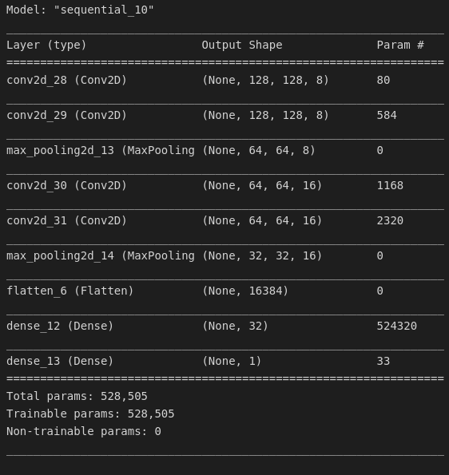
Model summary
-> showing layers, shapes and number of trainable parameters
model=create_base_model(train_data)
# Compile the model
loss_function=tf.keras.losses.binary_crossentropy
optimizer = tf.keras.optimizers.Adam(0.001)
model.compile(loss=loss_function, optimizer=optimizer, metrics=['accuracy’])
# Split data, define batches, number of epochs etc,
verbosity = 1
no_epochs=10
batch_size=10
# Fit model to data -> No data yet !
model.fit(train_data, train_labels, validation_data=(val_data,val_labels),
batch_size=batch_size, epochs=no_epochs, verbose=verbosity, shuffle=True)

Slide 23
Preparing the data

Slide 24
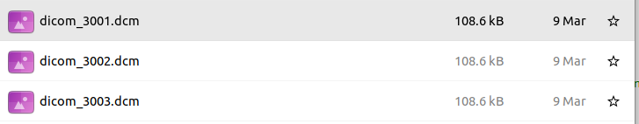
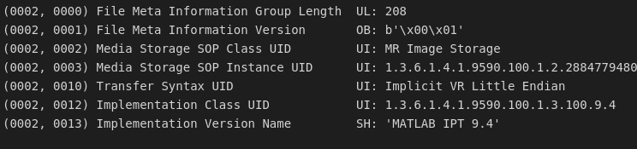
DICOM data
Unorganised Dataset
4106 DICOM files
DICOM
- Header
PatientID - Separate the different patients
SeriesNumber - Order slices from the same patient
InstanceNumber - Order time points for each series/slice
ProtocolName - Label for the data type e.g. SAX, LAX or 4Ch
- Image
Organised Dataset
74 patients
Array of data (nsamples,X,Y, channel)
Array of labels (nsamples, output channel)
183 different slices (124 SAX, 42 non SAX)
Notes:
A crucial step in Machine learning is obviously the data used.
From a list of DICOM files you need to prepare the data to obtain data digestible for TensorFlow or whichever machine learning software you desire to use.
A DICOM consists of :
a header with information relative to the patient and imaging.
And the image.
Here we use 4 header informations to organize the data.
PatientID - Separate the different patients
SeriesNumber - Order slices from the same patient
InstanceNumber - Order time points for each series/slice
ProtocolName - Label for the data type e.g. SAX, LAX or 4Ch
To finally obtain an organized Dataset.

Slide 25

Formatting the data
Image: int32
Image: float32 [0 1]
Input size 128x128
Store with all samples
Nsamples x 128 x 128 x 1
DICOM
Database
Label: text
‘SAX’
Label: hot encoded
1
Label: hot encoded
1
Notes:
Further preprocessing is often necessary.
In our exemple, we
- Convert the data to normalized float values, crop the images to (128,128).
- Convert string labels to [0 1] values.

Slide 26
Splitting the data
Organised Dataset
All patients
Training
60 %
Validation
20 %
Test
20 %
Training
SAX
Training
Non SAX
Val
SAX
Val
Non SAX
Test
SAX
Test
Non SAX
Notes:
Once the dataset is organised, we split the data into a training set, Validation set and Test Set.
The dataset is split to provide balanced numbers of SAX and non SAX,
Have enough exemples of each case to learn the task and evaluate the network.

Slide 27
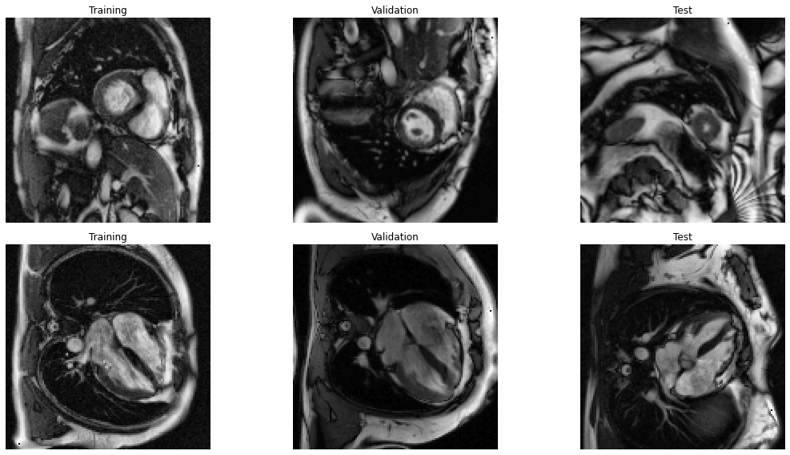
Vizualizing the data
Python array:
train_data: train_data.shape -> (nsamples, 128, 128, 1)
Access sample #0 :
plt.imshow(train_data[0,:,:,0] ,cmap=‘gray’)
Access last sample (#-1):
plt.imshow(train_data[-1,:,:,0], cmap=‘gray’)
Don’t forget to look at the images!
Notes:
Once the dataset is organised, we split the data into a training set, Validation set and Test Set.
The datasets are split on the patients level to avoid information leakage between the different datasets -> two closeby slices of a stack of short axis for exemple.
Have enough exemples of each case to learn the task and evaluate the network.

Slide 28
Hands on: Preparing the data and running the model

Slide 29
Downloading the data to the downloadpath folder
images_url="https://media.githubusercontent.com/media/mrphys/MLinCHD_Workshop/WIP_Workshop2/Workshop2/data/DICOMfiles.zip"
!wget {images_url} -P {downloadpath}
tmp_path=downloadpath+'/DICOMfiles.zip'
image_path=downloadpath+'/Workshop/'
!unzip {tmp_path} -d {image_path}
image_path=downloadpath+'/Workshop/DICOMfiles/'
Downloads the data from github
Decompress the data into specified folder

Slide 30
Reading and organizing the data
for file in np.sort(os.listdir(image_path)):
# Check whether file is in dcm format or not
if file.endswith(".dcm"):
# read file
file_path = f"{image_path}{file}"
ds = dicom.dcmread(file_path)
# store meta data dataType.append(ds.ProtocolName); dataID.append(ds.PatientID[3:6]); dataSeriesNo.append(ds.SeriesNumber); dataInstanceNo.append(ds.InstanceNumber) # store metadata
# process image data to ensure all data is square and resample to 128x128 matrix
inData = ds.pixel_array
minSz = min(inData.shape[0], inData.shape[1])
startX = math.floor((inData.shape[0]-minSz)/2); startY = math.floor((inData.shape[1]-minSz)/2) image_resampled = inData[startX:startX+minSz, startY:startY+minSz, tf.newaxis]
image_resampled = tf.image.resize(image_resampled, [imageSize,imageSize])
#Contrast Normalization (CLAHE) and scaled between [0 1]
image_preproc=tf_clahe.clahe(image_resampled/np.max(image_resampled)*256)/256
dataImage.append(image_preproc)
#Ordered Dictionary structure
data=dict()
data['dataImage']=dataImage
data['dataID']=np.stack(dataID).astype(np.int16)
data['dataType']=dataType
data['dataSeriesNo']=np.stack(dataSeriesNo).astype(np.int16)
data['dataInstanceNo']=np.stack(dataInstanceNo).astype(np.int16)

Slide 31
Function assembling the dataset
def assemble_dataset(data,indexes_time=[0],central_slice=1):
uniqueIDs = np.unique(data['dataID'])
dataID2=np.stack(data['dataID'])
PatientsData = [[[] for i in range(len(uniqueIDs))] for i in range(2)]
PatientsLabel = [[[] for i in range(len(uniqueIDs))]for i in range(2)]
imagecounter=0
for ii,file in enumerate(np.sort(os.listdir(image_path))):
if dataType[ii] == 'SAX’:
classificationLabel = 1
for index_time in indexes_time:
if data['dataInstanceNo'][ii]==index_time+1:
PatientsData[classificationLabel][dataID2.astype(np.int16)[ii]-1].append(data['dataImage'][ii])
else:
classificationLabel = 0
for index_time in indexes_time:
if data['dataInstanceNo'][ii]==index_time+1:
PatientsData[classificationLabel][dataID2.astype(np.int16)[ii]-1].append(data['dataImage'][ii])
if central_slice==1:
SAXelements=[item[len(item)//2] for item in PatientsData[1] if item!=[] ]
else:
SAXelements = [item for sublist in PatientsData[1] for item in sublist]
SAXLabels=np.ones((len(SAXelements),1))
nonSAXelements = [item for sublist in PatientsData[0] for item in sublist]
nonSAXLabels=np.zeros((len(nonSAXelements),1))
return SAXelements, SAXLabels, nonSAXelements, nonSAXLabels

Slide 32
Splitting the dataset
# Assemble Dataset
SAXelements, SAXLabels, nonSAXelements, nonSAXLabels=assemble_dataset(data,indexes_time=[10])
# Split the dataset into training, validation and test set
train_perc=60/100
val_perc=20/100
TrainElements=SAXelements[:int(train_perc*len(SAXelements))]+nonSAXelements[:int(train_perc*len(nonSAXelements))]
train_labels=np.concatenate((SAXLabels[:int(train_perc*len(SAXelements))],nonSAXLabels[:int(train_perc*len(nonSAXelements))]),axis=0)
Validation Dataset …
Test Dataset …
train_data=np.stack(TrainElements); val_data=np.stack(ValElements); test_data=np.stack(TestElements)
#Plot Images:
fig=plt.figure(figsize=(16,8))
plt.subplot(221)
plt.imshow(train_data[0,:,:,0],cmap='gray’); plt.axis('off’); plt.title('Training')
plt.subplot(222)
plt.imshow(val_data[0,:,:,0],cmap='gray’); plt.axis('off’); plt.title('Validation')
plt.subplot(223)
plt.imshow(train_data[-1,:,:,0],cmap='gray’); plt.axis('off’); plt.title('Training')
plt.subplot(224)
plt.imshow(val_data[-1,:,:,0],cmap='gray’); plt.axis('off’); plt.title('Validation')

Slide 33
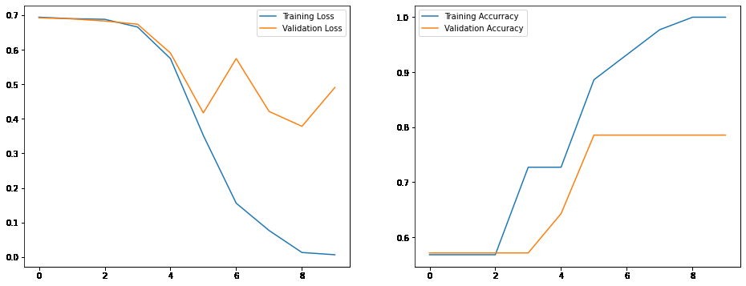
Training the model
tf.random.set_seed(1)
np.random.seed(1)
model=create_base_model(train_data)
# Compile the model
loss_function=tf.keras.losses.binary_crossentropy
learning_rate=0.0001
optimizer = tf.keras.optimizers.Adam(learning_rate)
model.compile(loss=loss_function, optimizer=optimizer, metrics=['accuracy'])
# Define batches, number of epochs etc,
verbosity = 1; no_epochs=10; batch_size=1
# Fit model to data
history = model.fit(train_data, train_labels,
validation_data=(val_data,val_labels),
batch_size=batch_size,
epochs=no_epochs,
verbose=verbosity,
shuffle=True)
fig = plt.figure(figsize=(16,6))
plt.subplot(121) # Plot the training curves
plt.plot(history.history['loss'], label='Training Loss')
plt.plot(history.history['val_loss'], label='Validation Loss')
leg = plt.legend()
plt.subplot(122)
# Plot the training curves
plt.plot(history.history['accuracy'], label='Training Accurracy')
plt.plot(history.history['val_accuracy'], label='Validation Accuracy')
leg = plt.legend()

Slide 34
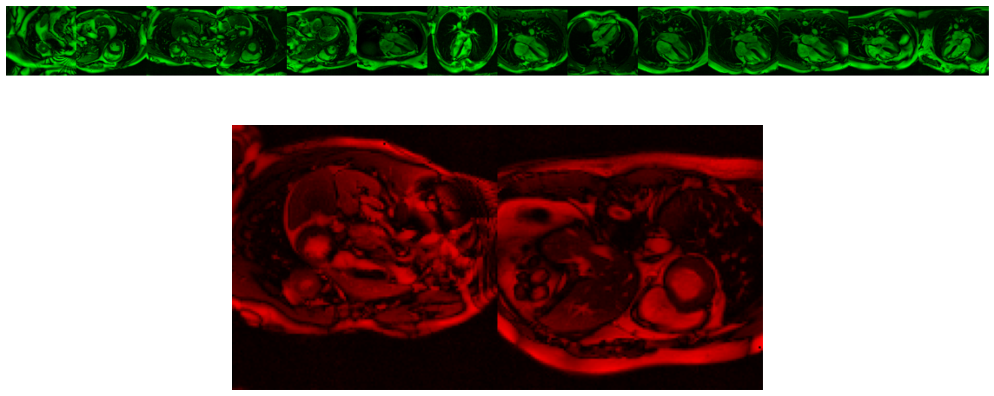
Test set results
#Plot Test set (green correct, red incorrect)
## Evaluate the model on the test set
testeval = model.evaluate(test_data,test_labels); results = model.predict(test_data)
1/1 [==============================] - 0s 16ms/step - loss: 0.2206 - accuracy: 0.8750
#Visualize results
fig=plt.figure(figsize=(16,8))
plt.subplot(211)
indexes=np.squeeze((test_labels>0.5)==(results>0.5))
PositiveImages=np.reshape(test_data[indexes,:,:,0],(-1,128))
PositiveImages=np.stack((np.zeros(PositiveImages.shape),PositiveImages,np.zeros(PositiveImages.shape)),axis=-1)
plt.imshow(np.transpose(PositiveImages,axes=(1,0,2)))
plt.axis('off')
plt.subplot(212)
….

Slide 35
Conclusion
Clarifying the basic blocks of classification.
Building a model
Preparing the data
Hopefully this helps you all to start off your own projects.
The tutorials and data as well as the video of this talk will be available on the github repository.

Slide 36


Thank you for your attention!
Rebecca Baker
Sheena Bhagirath
Olivier Jaubert
Saeed Karimi-Bidhendi
Dan Knight
Vivek Muthurangu
Jennifer Steeden

Slide 37
Improving performance and avoiding pitfalls

Slide 38
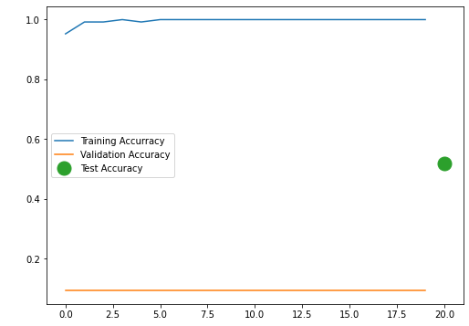
Experiment 1: Overfitting
Dataset split:
(SAX/not-SAX: 125 / 1 ), in validation: 32 ( 3 / 29 ), and in testing: 25 ( 13 / 12 )
Test Set:
Classified as SAX/really SAX/Intersection 25 / 13.0 / 13.0
The network is labelling all data as SAX
Solution: Balance the dataset/ show more non-SAX examples
Notes:
Here we witness a severe case of overfitting.
The naïve split between training/validation and test sets leads to a network classifying all data as SAX in the unseen data.
The model is not learning anatomy as we would like but finds a perfect solution on the training dataset.

Slide 39
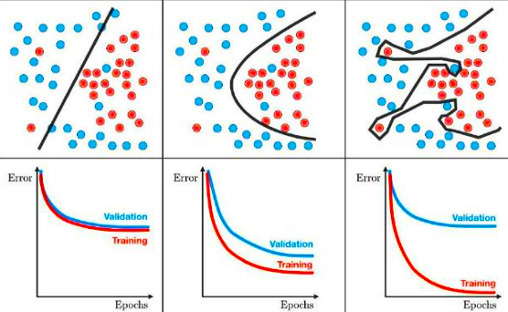
Overfitting
Notes:
As a refresher from last class we show here typical cases of underfitting, near ideal fitting and clear over fitting.
As you can see although the overfitting would split the training data perfectly, it will very poorly generalize to new data. (a point here would more probably be blue than red).
One of the points of overfitting is that it does not capture the characteristics you were aiming for.

Slide 40
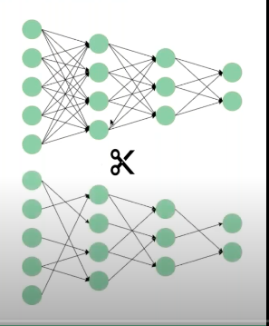
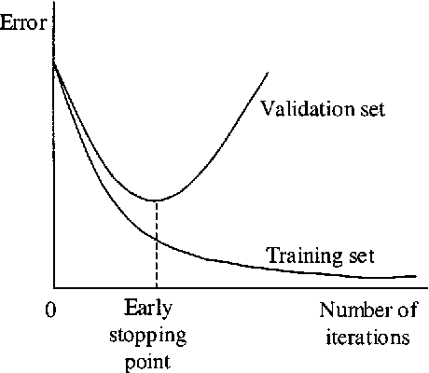
Preventing overfitting
Model Centric
How can you change the model to improve performance?
Data Centric
How can you systematically change your data to improve performance?
Model architecture (number of layers/features etc)
Early stopping
Regularize the model : Simplify the model, regularize the weights, add drop outs.
Data pre-processing/normalization
More Data helps fitting the model
Data Augmentation: Artificially increase the size of the dataset using the same labels
SAX
SAX
SAX
Notes:
There has been a lot of proposed ways to reduce overfitting.
I would separate them in two categories, the model centric (How can you …)
Examples of that are …
and data centric (how can you …).
Both should always be considered however due to the availability of generally well performing models it is often the data centric part which can bring the biggest improvements.

Slide 41
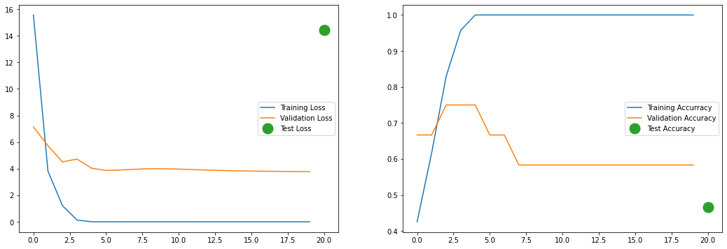
Experiment 2: Balancing the dataset
Dataset split:
47 (SAX/not-SAX: 23 / 24 ), in validation: 12 ( 6 / 6 ), and in testing: 15 ( 3 / 12 )
Test Set:
Classified as SAX/really SAX/Intersection 9 / 3.0 / 2.0
Severe case of overfitting
Still only slightly better than a coin toss
Notes:
Here our model is as good as a random guess on the validation set …
What we witness is a severe case of overfitting where the model perfectly classifies the training data but still performs pretty poorly on validation and test set.
The model is not learning anatomy as we would like but finds a perfect solution on the training dataset which does not generalize even to similar data

Slide 42
Experiment : Early stopping ?
Select model with best performance on validation set
Severe case of overfitting
Notes:
Here our model is as good as a random guess on the validation set …
What we witness is a severe case of overfitting where the model perfectly classifies the training data but still performs pretty poorly on validation and test set.
The model is not learning anatomy as we would like but finds a perfect solution on the training dataset which does not generalize even to similar data

Slide 43
Classifying orientation
Notes:
If we go back to our dataset we can see the huge variability in terms of anatomies, contrast, noise characteristics, etc.
It turns out that classifying through man-made features is harduous, shows poor performance and is not very generalizable to different problems. For instance recognizing the difference between a cat and a plane might have very different rules.
Yet we find this task very easy. After seeing only a few exemples you can recognize a short axis from long axis.

Slide 44
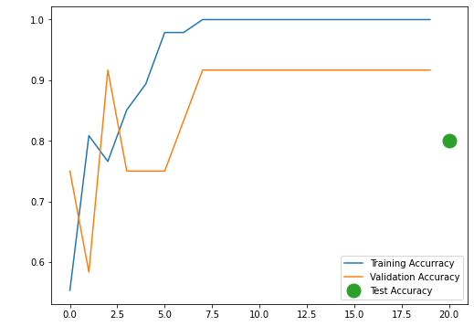
Experiment 3: Curating the dataset
Random orientation
Consistent orientation
Notes:
Here our model is as good as a random guess on the validation set …
What we witness is a severe case of overfitting where the model perfectly classifies the training data but still performs pretty poorly on validation and test set.
The model is not learning anatomy as we would like but finds a perfect solution on the training dataset which does not generalize even to similar data

Slide 45
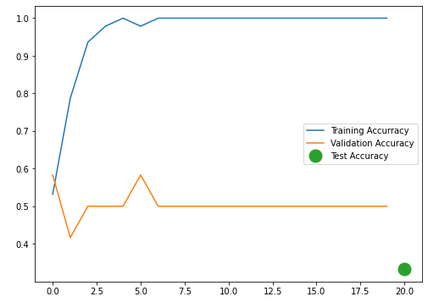
Experiment 2: Balancing the dataset
Severe case of overfitting
Notes:
Here our model is as good as a random guess on the validation set …
What we witness is a severe case of overfitting where the model perfectly classifies the training data but .
The model is not learning anatomy as we would like but finds a perfect solution on the training dataset which does not generalize even to similar data

Slide 46
Experiment 3: Balancing the dataset
Severe case of overfitting
Notes:
Here our model is as good as a random guess on the validation set …
What we witness is a severe case of overfitting where the model perfectly classifies the training data but .
The model is not learning anatomy as we would like but finds a perfect solution on the training dataset which does not generalize even to similar data

Slide 47
Old slides

Slide 48





Building a neural network
input layer
hidden layer
hidden layer
output layer
age
$$x_{1}$$
output
salt intake
$$x_{2}$$
$$y$$
blood pressure
body mass index
$$x_{3}$$
alcohol intake
$$x_{4}$$
dense or fully-connected layers

Slide 49
An artificial neuron
inputs
weights
neuron or unit
age
$$x_{1}$$
$$×w_{1}$$
$$×w_{2}$$
output
salt intake
$$x_{2}$$
$$+b$$
$$h$$
$$y$$
blood pressure
body mass index
$$x_{3}$$
$$×w_{3}$$
bias
activation function
alcohol intake
$$x_{4}$$
$$×w_{4}$$
$$x$$
$$w$$
$$y=h\left(w⋅x+b\right)$$

Slide 50




Activation functions
An activation function defines the output of a neuron.
linear
rectified linear unit (ReLU)
logistic or sigmoid
Only nonlinear activation functions enable neural networks to learn nontrivial relationships!

Slide 51
Building a neural network
input layer
hidden layer
hidden layer
output layer
age
$$x_{1}$$
output
salt intake
$$x_{2}$$
$$y$$
blood pressure
body mass index
$$x_{3}$$
alcohol intake
$$x_{4}$$
dense or fully-connected layers

Slide 52
Hyperparameters
There are many ways to configure the model and/or the training process.
How many hidden layers should we use?
How many neurons in each layer?
These values are called hyperparameters and they cannot be learned.
Usually we define them manually, and we experiment with different combinations to see what works best.

Slide 53
What about image inputs?
input layer
hidden layer
hidden layer
output layer
pixel 1
$$x_{1}$$
output
pixel 2
$$x_{2}$$
$$y$$
cardiac orientation
pixel 3
$$x_{3}$$
pixel 4
$$x_{4}$$
dense or fully-connected layers

Slide 54


Loss functions
The loss function represents the cost associated with a model’s predictions.
The training process aims to find a set of parameters that minimize the loss function.
A good loss function should capture the quality of a prediction (low value $↔$ good quality, high value $↔$ poor quality).

Slide 55



The role of gradients
The gradient always points in the direction in which a function rises most steeply.
Gradients drive parameter updates and play a crucial role in training neural networks.
For this to be possible, neural networks must use functions for which a gradient exists. Such functions are said to be differentiable.
Fortunately, gradients can be easily computed for many functions.
–
gradient of $ℒ$ w.r.t. to $θ$
loss $ℒ$
parameter $θ$

Slide 56


The gradient descent algorithm
The gradient descent algorithm is an iterative method to find the minimum of a differentiable function.
In each iteration, the algorithm takes a step towards the minimum.
The size of the steps is proportional to the gradient and to a parameter called learning rate.
loss $ℒ$
parameter $θ$

Slide 57






The effect of the learning rate
too small
good
too large
loss $ℒ$
loss $ℒ$
loss $ℒ$
parameter $θ$
parameter $θ$
parameter $θ$
The learning rate can have a very large impact on final model performance. It should always be chosen appropriately.

Slide 58
Common loss functions
Which loss function is appropriate depends on the task. Some of the most common include:
Mean squared error (regression tasks).
Cross-entropy (classification tasks). Can be binary (binary classification) or categorical (multiclass classification).
Notes:
TODO: epochs

Slide 59




inputs
neural network or model
labels
$$y= x$$
X: 0, 1, 2, 3, 4, 5
$$y=2x−4$$
Y: -4, -2, 0, 2, 4, 6
$$w +b$$
$$−1 +1$$
Training a neural network
guess
loss function
(e.g. MSE)
update
compare
optimizer
(e.g. SGD)
True
Model
Notes:
TODO: epochs

Slide 60
Optimizers
An optimizer is an algorithm that specifies how to update the model’s parameters at each training iteration.
All optimizers use the gradient of the loss w.r.t. to each parameter.
The most basic optimizer (stochastic gradient descent) simply updates the weights in the direction of the gradient with a fixed step size (learning rate).
Better optimizers may also remember previous iterations and/or adapt their step size (e.g., Adam).
Notes:
TODO: epochs

Slide 61
Batches
Neural networks usually process training examples in batches.
A batch is a set of examples which are used to estimate the loss and gradients during a training iteration. The network’s parameters are updated once for each batch.
Smaller batches result in noisier updates, but each iteration has a lower cost.

Slide 62

https://playground.tensorflow.org/

Slide 63
Data and generalization

Slide 64
The importance of data
Machine learning works by fitting a model to some data. Therefore, the availability of data is essential to success.
In general, having more data allows us to build better models.
Data quality (e.g., correct labels) is also very important, especially when the total amount of data is not very large.
In medical imaging, training datasets are often relatively small (typically in the range of hundreds or a few thousand examples).
There are techniques that help us make the most of the available data, such as data augmentation. You will learn more about these in the next sessions.

Slide 65










Generalization
To be useful, models need to generalize to previously unseen data.

Slide 66
The bias-variance trade-off
We want the model to capture important regularities in the data while discarding noisy or unrepresentative information. The trade-off between these two requirements is called the bias-variance trade-off.
underfitting
good balance
overfitting

Slide 67

Training and test sets
The data we use to train a model is referred to as the training set.
We must always evaluate models using a test set which is independent from the training set.
training set
test set
train
evaluate

Slide 68


Why we need a validation set
training set
test set
validation set
test set
train
evaluate
evaluate
information is leaking from the test set!

Slide 69
Training, validation and test datasets
training set
validation set
test set
used to fit the model’s parameters
used to optimize the model during development
used to provide an unbiased evaluation of the final model

Slide 70
Splitting the data
Usually we only have one dataset, and it is up to us to split it into a training set, a validation set and a test set.
It is common to see train-validation-test splits such as 80-10-10% or 70-10-20%, but this depends on the problem.
We need enough validation/test data to evaluate our model with confidence, but we also want to maximise the amount of training data.
For very large datasets, the proportion used for training is typically larger (e.g. 98-1-1%).

Slide 71
Splitting the data
Typically, the best approach is to perform the split randomly.
But sometimes we might want to take special care, e.g., to ensure adequate representation of different subgroups within each dataset.
We must ensure that the resulting datasets are truly independent.
For example, medical images from the same patient should all be assigned to the same dataset.

Slide 72

Data scope
The datasets must be representative of the population in which a model is to be used.

Slide 73
Data scaling
Neural networks are sensitive to the scale of their inputs and outputs.
Inappropriate scaling can make the learning process difficult or unstable.
A good rule of thumb is that input and output values should be small, around [0, 1] or [-1, 1].
In the case of outputs, the data range must match that of the

Slide 74

Data scaling
Normalization maps the minimum input value to 0 and the maximum input value to 1. It is very common to do this when processing images, which often come in the range [0, 255] (natural images) or [0, 4095] or [-2048, 2047] (DICOM).
$$x=\frac{x−\min\left(x\right)}{\max\left(x\right)−\min\left(x\right)}$$
pixel values in range [0, 4095]
pixel values in range [0, 1]
divide by 4095

Slide 75

Data scaling
Another common preprocessing operation is standardization, which rescales the input values to have zero mean and unit variance. This is well suited to normally distributed data.
$$x=\frac{x−\operatorname{mean}\left(x\right)}{\operatorname{std}\left(x\right)}$$

Slide 76


Data preprocessing
Some preprocessing operations, such as rescaling, may be performed at an instance level or a dataset level.
instance level
dataset level
we only look at the current example to apply the operation
we look at the entire dataset to apply the operation
easier to implement changes the relationship between examples
harder to implement the relationship between examples does not change

Slide 77
Data preprocessing
We often need to transform data prior to processing by a neural network.
A common transformation is data scaling. This is important because neural networks are sensitive to the scale of their inputs and outputs. A good rule of thumb is that input and output values should be small, around [0, 1] or [-1, 1].
pixel values in range [0, 255]
pixel values in range [0, 1]
divide by 255

Slide 78







Categorical variables
Sometimes input and/or output variables are categorical. Categorical variables take one of several possible values, which do not need to be numeric.
However, deep learning algorithms are designed to operate on continuous, numeric data.
one-hot encoding
$$p_{rock}$$
$$p_{paper}$$
$$p_{scissors}$$
set the $p$ for the correct class to 1, and the rest to 0
[ 1 , 0 , 0 ]
“paper”
“scissors”
“rock”
1
2
0
[ 0 , 1 , 0 ]
[ 0 , 0 , 1 ]

Slide 79
Predicting probability distributions
The logits are the raw (non-normalized) predictions of a neural network.
The softmax function can be used to normalize the logits to a probability distribution over the predicted output classes.
logits
probabilities
labels
1.8
0.06
0
softmax
4.5
0.85
1
2.2
0.09
0
loss (e.g., categorical cross-entropy)

Slide 80
Fashion MNIST

Slide 81
Fashion MNIST
T-shirt/top
T-shirt/top
dress
pullover
sneaker
pullover
sandal
sandal
ankle boot
sneaker
trouser
shirt
coat
dress
trouser
coat
bag
shirt
bag
ankle boot
trouser

Slide 82
Fashion MNIST
Label | Description
0 | T-shirt/top
1 | Trouser
2 | Pullover
3 | Dress
4 | Coat
5 | Sandal
6 | Shirt
7 | Sneaker
8 | Bag
9 | Ankle boot
Training set: 60,000 examples
Test set: 10,000 examples
28 × 28 images
10 classes, labelled 0 to 9

Slide 83
Hands-on: Image classification using a dense neural network

Slide 84
import tensorflow as tf
(train_images, train_labels), (test_images, test_labels) = (
tf.keras.datasets.fashion_mnist.load_data())
# Normalize the images to the range [0, 1].
train_images = train_images.astype("float32") / 255
test_images = test_images.astype("float32") / 255
# Transform labels using one-hot encoding
# (e.g., 2 -> [0, 0, 1, 0, 0, 0, 0, 0, 0, 0]).
train_labels = tf.one_hot(train_labels, depth=10)
test_labels = tf.one_hot(test_labels, depth=10)

Slide 85
model = tf.keras.Sequential([
tf.keras.layers.Flatten(input_shape=[28, 28]),
tf.keras.layers.Dense(units=128, activation='relu’),
tf.keras.layers.Dense(units=10, activation='softmax')
])
model.compile(optimizer='adam',
loss='categorical_crossentropy',
metrics=['accuracy'])
history = model.fit(train_images, train_labels, epochs=10)
model.evaluate(test_images, test_labels)

Slide 86
Epoch 1/10
1875/1875 [==============================] - 2s 802us/step - loss: 0.7430 - accuracy: 0.7596
Epoch 2/10
1875/1875 [==============================] - 1s 794us/step - loss: 0.5110 - accuracy: 0.8260
Epoch 3/10
1875/1875 [==============================] - 2s 805us/step - loss: 0.4654 - accuracy: 0.8390
Epoch 4/10
1875/1875 [==============================] - 2s 802us/step - loss: 0.4396 - accuracy: 0.8480
Epoch 5/10
1875/1875 [==============================] - 2s 802us/step - loss: 0.4221 - accuracy: 0.8541
Epoch 6/10
1875/1875 [==============================] - 2s 808us/step - loss: 0.4078 - accuracy: 0.8581
Epoch 7/10
1875/1875 [==============================] - 2s 802us/step - loss: 0.3964 - accuracy: 0.8624
Epoch 8/10
1875/1875 [==============================] - 2s 808us/step - loss: 0.3861 - accuracy: 0.8661
Epoch 9/10
1875/1875 [==============================] - 2s 803us/step - loss: 0.3775 - accuracy: 0.8685
Epoch 10/10
1875/1875 [==============================] - 2s 810us/step - loss: 0.3705 - accuracy: 0.8706
313/313 [==============================] - 0s 877us/step - loss: 0.4293 - accuracy: 0.8443

Slide 87
Introduction to convolutional neural networks

Slide 88





input layer
hidden layer
hidden layer
output layer
pixel 1
$$x_{1}$$
output
pixel 2
$$x_{2}$$
$$y$$
pixel 3
$$x_{3}$$
pixel 4
$$x_{4}$$
dense or fully-connected layers

Slide 89

Two new layer types
The two main components of convolutional neural networks are convolutional layers and pooling layers.
These are loosely inspired by the structure of the visual cortex.

Slide 90



The convolution operation

Slide 91

Introducing convolutions

Slide 92







The convolution operation
$$−1×0+0×0+1×1 \\ −1×0+0×0+1×0$$
$$−1×1+0×1+1×1$$
$$=1$$
filter
image
filtered image

Slide 93

The convolution operation
filter
image
filtered image

Slide 94

The convolution operation
filter
image
filtered image

Slide 95



The convolution operation
image
filtered image

Slide 96
The convolution operation
-1 | 0 | 1
-1 | 0 | 1
-1 | 0 | 1
convolve
image
features
This is a vertical edge detector!

Slide 97
Feature extraction
? | ? | ?
? | ? | ?
? | ? | ?
?
-1 | 0 | 1
-1 | 0 | 1
-1 | 0 | 1
-1 | -1 | -1
0 | 0 | 0
1 | 1 | 1
-2 | 4 | -5
2 | 4 | -3
1 | 0 | -4
0 | 2 | 1
-5 | -2 | -5
-1 | 2 | 1
convolve
image
features

Slide 98




The pooling operation
image
downsampled image

Slide 99

The pooling operation
image
downsampled image

Slide 100

The pooling operation
image
downsampled image

Slide 101



The pooling operation
image
downsampled image

Slide 102
Building a convolutional neural network
higher resolution
higher level semantics
4 feature maps or channels
8 feature maps
conv
pool
conv
pool
? | ? | ?
? | ? | ?
? | ? | ?
filter or kernel
? | ? | ?
? | ? | ?
? | ? | ?
? | ? | ?
? | ? | ?
? | ? | ?
? | ? | ?
? | ? | ?
? | ? | ?
× 4 filters
? | ? | ?
? | ? | ?
? | ? | ?
× 8 filters
kernel size
trainable parameters

Slide 103

Hierarchical representations
shallow layers
low-level features
intermediate layers
mid-level features
deep layers
high-level features
Adapted from Lee et al. (2011). Unsupervised Learning of Hierarchical Representations with Convolutional Deep Belief Networks.

Slide 104

A convolutional classifier
Conv
Conv
Dense
Conv
Dense
Conv
Pooling
Pooling
Conv
Conv
Pooling
SAX
feature extraction
classification

Slide 105
Convolutional vs dense layers
each output pixel depends on every input pixel
each output pixel has its own weights
# parameters: (128 × 128) × (128 × 128) = 268 M
dense
each output pixel depends only on its neighbours
different output pixels share weights
# parameters: 3 × 3 = 9
convolutional
Convolutions have inherent biases which make them a very efficient choice for image processing.

Slide 106
Hands-on: Image classification with convolutional neural networks

Slide 107
import tensorflow as tf
(train_images, train_labels), (test_images, test_labels) = (
tf.keras.datasets.fashion_mnist.load_data())
# Normalize the images to the range [0, 1].
train_images = train_images.astype("float32") / 255
test_images = test_images.astype("float32") / 255
# Transform labels using one-hot encoding
# (e.g., 2 -> [0, 0, 1, 0, 0, 0, 0, 0, 0, 0]).
train_labels = tf.one_hot(train_labels, depth=10)
test_labels = tf.one_hot(test_labels, depth=10)
# Add a channel dimension [28, 28] -> [28, 28, 1].
train_images = tf.expand_dims(train_images, axis=-1)
test_images = tf.expand_dims(test_images, axis=-1)

Slide 108
model = tf.keras.Sequential([
tf.keras.Input(shape=(28, 28, 1)),
tf.keras.layers.Conv2D(filters=32, kernel_size=(3, 3), activation="relu"),
tf.keras.layers.MaxPooling2D(pool_size=(2, 2)),
tf.keras.layers.Conv2D(filters=64, kernel_size=(3, 3), activation="relu"),
tf.keras.layers.MaxPooling2D(pool_size=(2, 2)),
tf.keras.layers.Flatten(),
tf.keras.layers.Dense(10, activation="softmax"),
])
model.compile(optimizer=tf.keras.optimizers.Adam(learning_rate=0.001),
loss="categorical_crossentropy",
metrics=["accuracy"])
history = model.fit(train_images, train_labels,
epochs=10,
validation_data=(test_images, test_labels))
model.evaluate(test_images, test_labels)

Slide 109
Epoch 1/10
1875/1875 [==============================] - 4s 1ms/step - loss: 0.4783 - accuracy: 0.8271 - val_loss: 0.3771 - val_accuracy: 0.8673
Epoch 2/10
1875/1875 [==============================] - 2s 1ms/step - loss: 0.3276 - accuracy: 0.8806 - val_loss: 0.3303 - val_accuracy: 0.8845
Epoch 3/10
1875/1875 [==============================] - 2s 1ms/step - loss: 0.2851 - accuracy: 0.8961 - val_loss: 0.3195 - val_accuracy: 0.8848
Epoch 4/10
1875/1875 [==============================] - 2s 1ms/step - loss: 0.2574 - accuracy: 0.9067 - val_loss: 0.2863 - val_accuracy: 0.8970
Epoch 5/10
1875/1875 [==============================] - 2s 1ms/step - loss: 0.2364 - accuracy: 0.9143 - val_loss: 0.2806 - val_accuracy: 0.8995
Epoch 6/10
1875/1875 [==============================] - 2s 1ms/step - loss: 0.2176 - accuracy: 0.9215 - val_loss: 0.2648 - val_accuracy: 0.9054
Epoch 7/10
1875/1875 [==============================] - 2s 1ms/step - loss: 0.2012 - accuracy: 0.9262 - val_loss: 0.2616 - val_accuracy: 0.9051
Epoch 8/10
1875/1875 [==============================] - 2s 1ms/step - loss: 0.1903 - accuracy: 0.9307 - val_loss: 0.2582 - val_accuracy: 0.9079
Epoch 9/10
1875/1875 [==============================] - 3s 1ms/step - loss: 0.1784 - accuracy: 0.9354 - val_loss: 0.2644 - val_accuracy: 0.9078
Epoch 10/10
1875/1875 [==============================] - 3s 1ms/step - loss: 0.1681 - accuracy: 0.9383 - val_loss: 0.2712 - val_accuracy: 0.9052
313/313 [==============================] - 0s 1ms/step - loss: 0.2712 - accuracy: 0.9052

Slide 110
import matplotlib.pyplot as plt
fig, ax = plt.subplots(1, 2)
ax[0].plot(history.history['loss'], label='train')
ax[0].plot(history.history['val_loss'], label='test')
ax[1].plot(history.history['accuracy'], label='train')
ax[1].plot(history.history['val_accuracy'], label='test')

Slide 111
Where to go next
SCMR Series of Hands-on Workshops on Machine Learning
A Classification Task in CHD
August 31st, 2022 • 17:00 BST Dr Olivier Jaubert
A Segmentation Task in CHD
September 28th, 2022 • 17:00 BST Dr Saeed Karimi-Bidhendi
TensorFlow website (guide, tutorials, documentation): https://www.tensorflow.org/
TensorFlow Playground (intuition about how neural networks process the data): https://playground.tensorflow.org/

Slide 112
Thank you for your attention!
Rebecca Baker
Sheena Bhagirath
Olivier Jaubert
Saeed Karimi-Bidhendi
Dan Knight
Vivek Muthurangu
Jennifer Steeden

